Slide 1
Image Classification
What we should focus on…
Taehyeon Kim
OsiLab

Slide 2
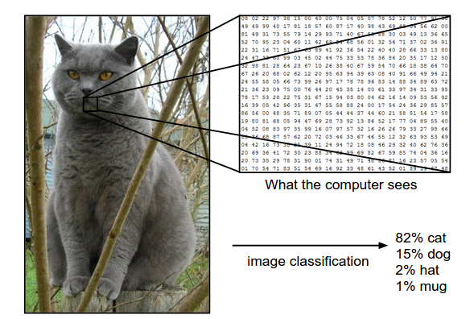
Image Classification
Supervised Learning!
Image is represented as one large 3-dimensional array of numbers.
Image has three color channels Red, Green, Blue (or RGB for short).
Cat: 248 pixels wide, 400 pixels tall
Then, it consists of 248 x 400 x 3 numbers, or a total of 297,600 numbers.

Slide 3
Image Classification
It is hard to make the algorithm directly, so instead of trying to specify what every one of the categories of interest look like directly in code, many provides the computer with many examples of each class and then develop learning algorithms that look at these examples and learn about the visual appearance of each class.
Data-Driven Approach
Then,
how to classify the data well with Deep Neural Network?
why we should use Deep Neural Network?
what kind of loss function we should use?
what is key idea of deep neural network?

Slide 4
Image Classification
MicroNet
Challenge
Taehyeon Kim
OsiLab

Slide 5
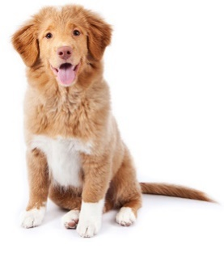
Image Classification
Intro
Continuity
Lipschitz of weight matrix
Orthogonality
Input
Data Augmentation
Output
One-hot vector
There are three main issues

Slide 6
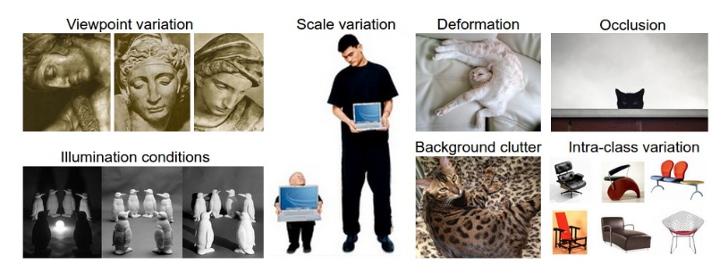
Image Classification
Then, which part we should focus?
Viewpoint variation : A single instance of an object can be oriented in many ways with respect to the camera.
Scale variation : Visual classes often exhibit variation in their size (size in the real world, not only in terms of their extent in the image).
Deformation : Many objects of interest are not rigid bodies and can be deformed in extreme ways.
Occlusion : The objects of interest can be occluded. Sometimes only a small portion of an object (as little as few pixels) could be visible.
Illumination conditions : The effects of illumination are drastic on the pixel level.
Background clutter : The objects of interest may blend into their environment, making them hard to identify.
Intra-class variation : The classes of interest can often be relatively broad, such as chair. There are many different types of these objects, each with their own appearance.
물체가 찍힌 구도
이미지 크기
물체 모양이??
일부만 나온 경우
조명 효과
배경이랑 비슷하게 생긴…
범주가 넓은 경우

Slide 7
CIFAR100 data augmentation
Task : required to achieve 80% top-1 accuracy on the CIFAR100 test set.
Description
CIFAR100 dataset is a bit different with others such CIFAR10 or ImageNet.
Composition
Training dataset: 50,000 (each class has 500 images)
Test dataset: 10,000
Number of classes: 100
Image size: 32 x 32 x 3 (3,072)
The number of images per each class is less than other datasets.
Namely, with data-driven approach, for especially CIFAR100, maybe one of the most important job is data augmentation.
CIFAR10 | IMAGENET | CIFAR100
5,000 | 732 – 1300 (Most: 1000) | 500

Slide 8
CIFAR100 data augmentation
Then,
Is it okay to use all below augmentation strategies without any consideration?
Don’t we have to arrange the following methods any way?
The answer is No.

Slide 9
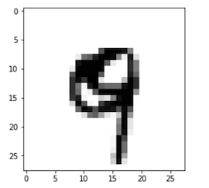
CIFAR100 data augmentation
Sometimes, this method can harm the performance
For example, let’s see MNIST dataset.
If we flip the number ‘9’, then the flipped image is useful for network? will be the network trained well?
No. It’s not. Instead, the accuracy decreases.
Therefore, data augmetation can improve your performance,
but it is not always true.
The more important thing is to find a proper augmentation strategy for your dataset.

Slide 10
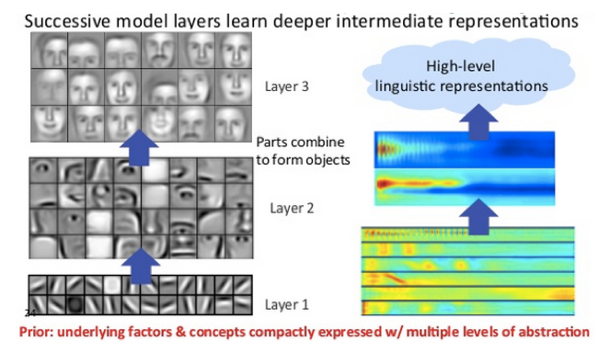
CIFAR100 architecture
Main Approach of Deep learning
Each layer of nodes trains on a distinct set of features based on the previous layer’s output. The further you advance into the neural net, the more complex the features your nodes can recognize, since they aggregate and recombine features from the previous layer.
Feature Hierarchy

Slide 11
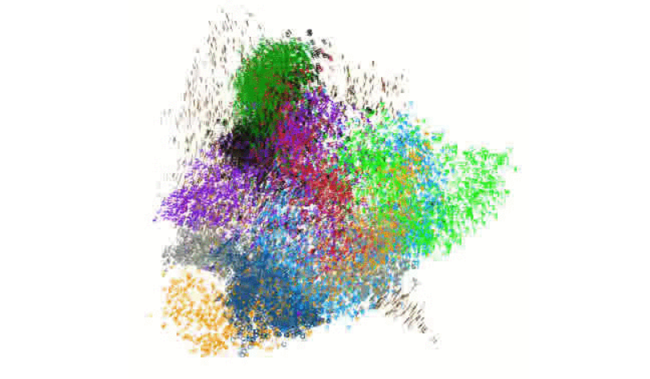
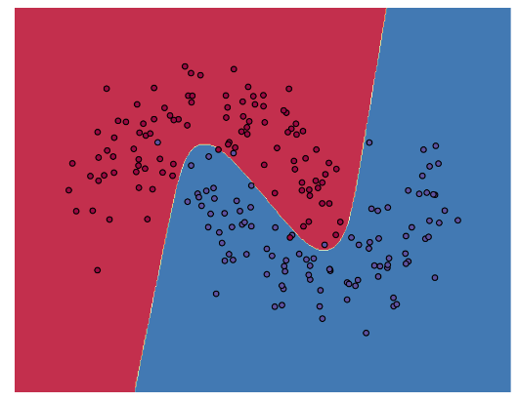
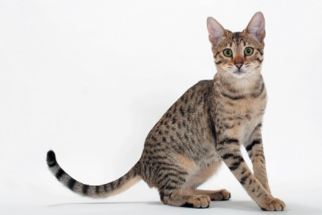


CIFAR100 architecture
My approach…
The main principle of deep learning architecture is to inject data towards high dimensional space.
Through this, they make the classification easier.
Increasing dimension $↑$
Decreasing dimension $↓$
high dimensional space
Decision Boundary

Slide 12
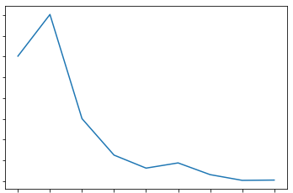
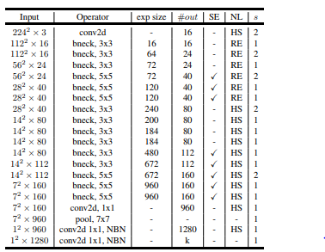


CIFAR100 architecture design
In many architecture, they pay more attention on decreasing the dimension of input data.
Namely, maybe, the key of CNN is finding the way how to reducing the dimension effectively.
Decreasing dimension $↓$
Increasing dimension $↑$
I want to find the optimal curve of above graph…
To get this,
Analyze the information gain and loss with the layerwise fashion.
Make visualization of each input tensor.
Figure. MobileNet V3

Slide 13
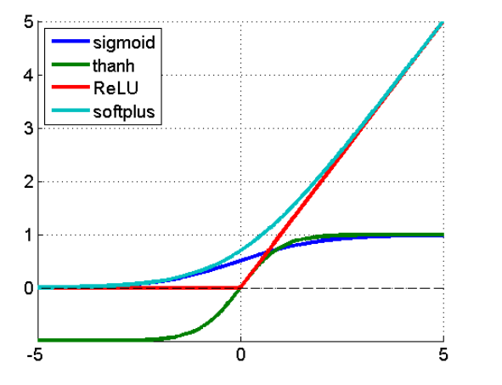
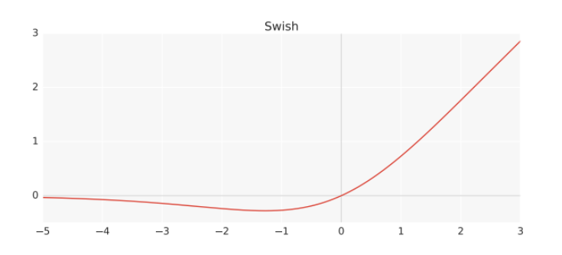
CIFAR100 activation function
To reduce the information loss when passing the next layer, nowadays, many use ‘swish’ activation function.
swish
f(x) = x · sigmoid(x)
Recently, the ‘hard swish’ function which approximates the swish is also proposed to reduce the computational costs.

Slide 14
Image Classification
Then, what should we do
Taehyeon Kim
OsiLab

Slide 15
CIFAR100 data augmentation
Now, I focus on the data augmentation policy.
Also, study about the architecture design strategy, but still there’s no remarkable analysis, so today i’ll introduce some recent data augmentation policies.
I can improve the accuracy with ‘AutoAugment method’ from 74.25% to 79.08%.
4.83% Improvement!!!
Parameters : 1M
Flops: 0.98B
But we cannot use autoaugment policy… so we have to make new augment rule.!!
HighpathNet (Mine) | No | With AutoAugment
Accurcay | 74.25% | 79.08%

Slide 16
CIFAR100 data augmentation
These are the state-of-the-art augment polices or popular augment polices.
Cutout [arXiv’17]
Mixup [ICLR’18]
DropBlock [NeurIPS’18]
Manifold Mixup [ICML’19]
AutoAugment [CVPR’19]
Cutmix [ICCV’19]
label smoothing [Under review]

Slide 17
CIFAR100 data augmentation
Cutout [arXiv’17]
Figure: cutout applied to images from the CIFAR-10 dataset
Pros: Very simple
Cons: Not work on ImageNet data
This can improve up to 1.5%.

Slide 18
CIFAR100 data augmentation
Mixup [ICLR’18]
From paper, this is called vicinity distribution that measures the probability of finding the virtual feature-target pair ($\tilde{x}, \tilde{y})$.
This encourages the model f to behave linearly in-between training examples.
Pros: Very simple
Cons: Not work on ImageNet data

Slide 19
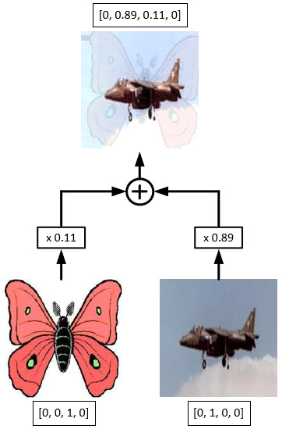
CIFAR100 data augmentation
Mixup [ICLR’18]
From paper, this is called vicinity distribution that measures the probability of finding the virtual feature-target pair ($\tilde{x}, \tilde{y})$.
This encourages the model f to behave linearly in-between training examples.

Slide 20
CIFAR100 data augmentation
Mixup [ICLR’18]
They also tried to use combinations of three or more examples with weights sampled from a Dirichlet distribution does not provide further gain, but increases the computation cost of mixup.
Their current implementation uses a single data loader to obtain one minibatch, and then mixup is applied to the same minibatch after random shuffling.
Interpolating only between inputs with equal label did not lead to the performance gains of mixup discussed in the sequel.

Slide 21
CIFAR100 data augmentation
DropBlock [NeurIPS’18]

Slide 22
CIFAR100 Feature regularization
DropBlock [NeurIPS’18]
Gradually, increasing number of dropped units during training leads to better accuracy and more robust to hyperparameter choices.

Slide 23
CIFAR100 data augmentation
AutoAugment [CVPR’19]
They use Reinforcement Learning as the search algorithm.
Key: The policy S will be used to train a neural network with a fixed architecture, whose validation accuracy R will be sent back to update the controller.

Slide 24
CIFAR100 data augmentation
AutoAugment [CVPR’19]
They use Reinforcement Learning as the search algorithm.
Key: The policy S will be used to train a neural network with a fixed architecture, whose validation accuracy R will be sent back to update the controller.

Slide 25
Image Classification
Thank You
Taehyeon Kim
OsiLab

Slide 26
Reference
http://cs231n.github.io/classification/

